Slide 1


Python Web apI - Restful
signup account / verify

Slide 2
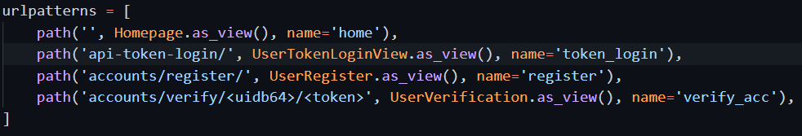
Add register url and verify URL
User/urls.py
The uidb64 will be keeping the user id. The token is one time token to verify this user.

Slide 3
Add email backend in settings
We are using real email address, so just use console to show the content.
Actual production webapp should configure to use SMTP email server, and all should be real email address.

Slide 4
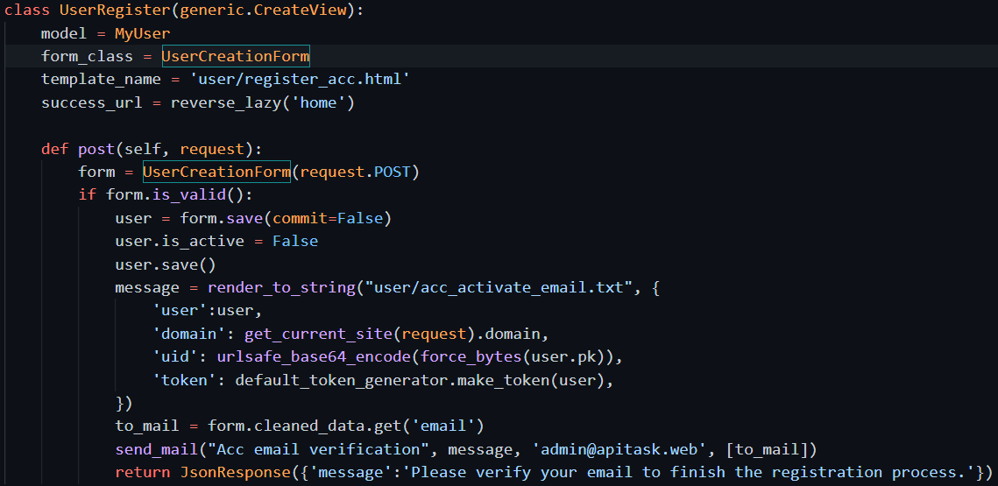
Add register view

Slide 5
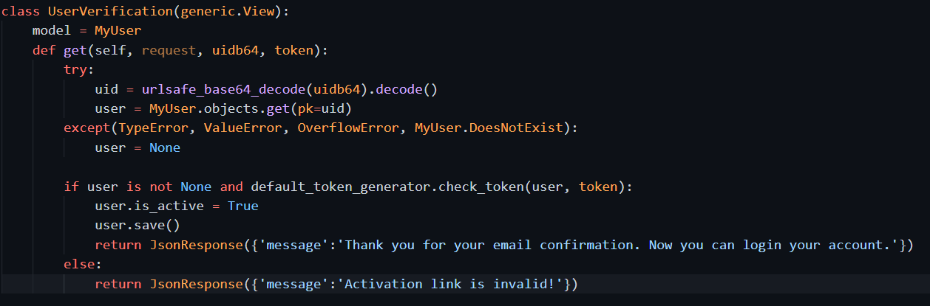
Add verify view

Slide 6
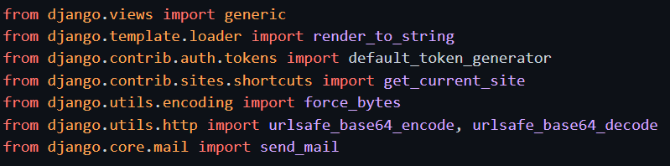
Functions/classes needed

Slide 7
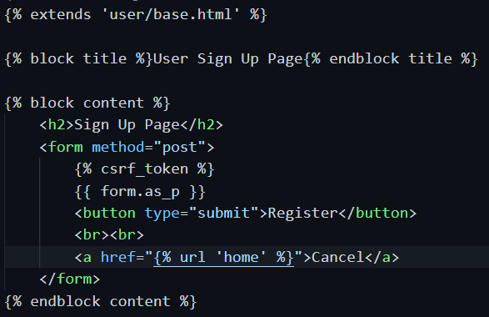
Template for register
User/register.html

Slide 8
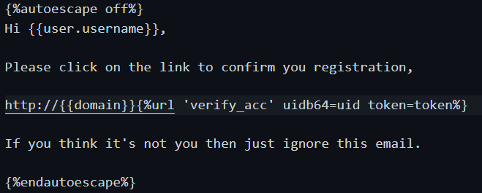
Template for verify email
User/acc_activate_email.txt
For compose email message

Slide 9
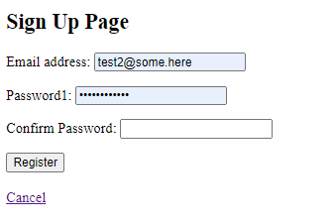

Using brower to check

Slide 10
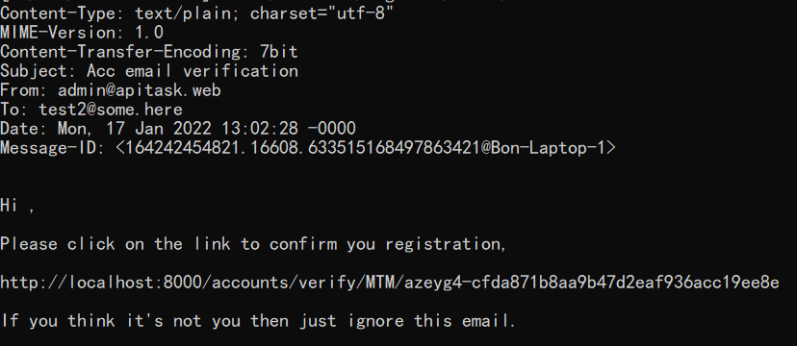
The email in console

Slide 11
The verify url visited

Slide 12
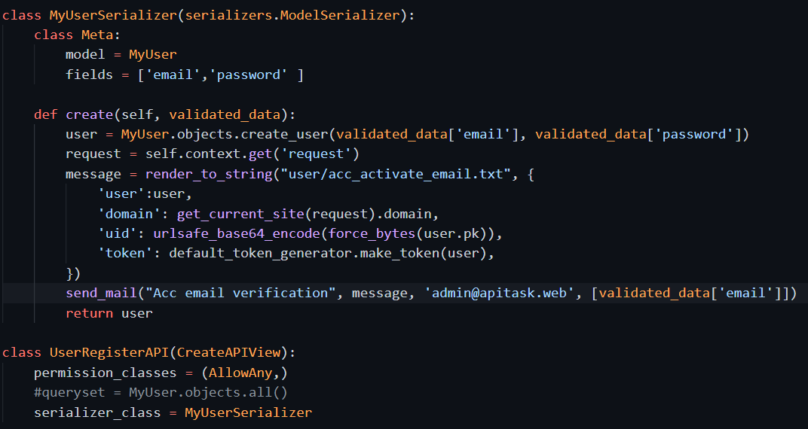
2nd way: we can use APIview

Slide 13
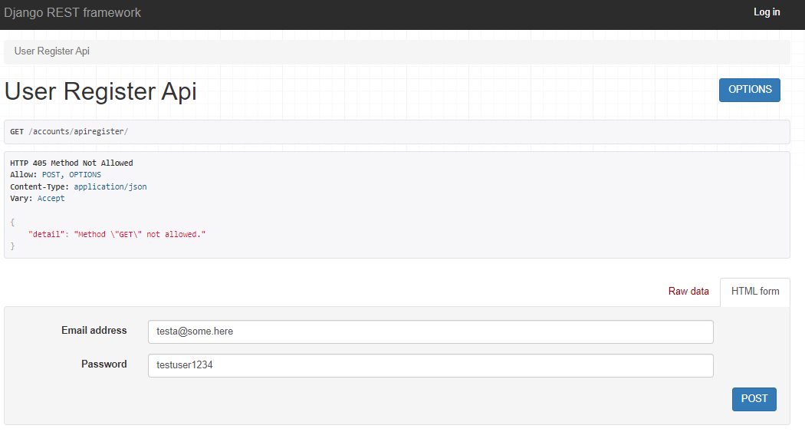
User browser to check
We are using only the createview. So only allow post.
Using browser will see get not allowed. But we still have the form

Slide 14
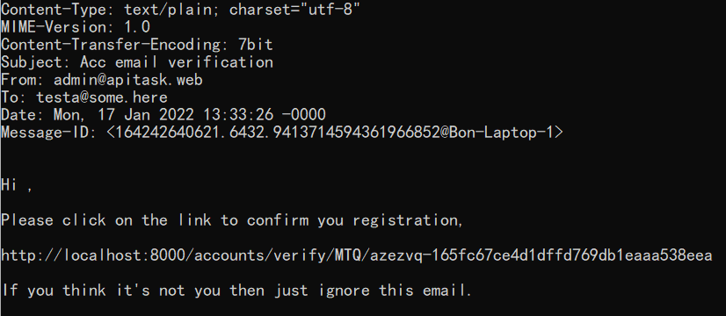
Verification of email is same

